Slide 1



FAKE NEWS CLASSIFICATION & PREDICTION
DATA 606 - CAPSTONE PROJECT
Project By:
Shivani Reddy Annaram

Slide 2

Under the guidance of
Prof. Chaojie (Jay) Wang

Slide 3


Contents
Modeling & Evaluation
Introduction
EDA & pre-processing
1
2
3

Slide 4
Abstract
Daily events have typically been reported by mass media sources, particularly the news media. The dependability of information on the internet has become a critical issue in
modern life in recent years. Fake news on social media and the Internet is influencing people to the point that it needs to be stopped. Our goal is to develop a reliable model that classifies a given information is either fake or true.

Slide 5
Introduction
Fake news isn't a new concept, it has been around for
decades. The beginning of the social media age, on the other hand, has multiplied the generation and spread of fake news. Fake news may simply be defined as an article made for financial, personal, or political advantage. Many scientists believe that the problem of fake news may be solved via machine learning and artificial intelligence. Various NLP approaches, Machine learning, and Artificial Intelligence can be used to detect such unrealistic news items. Such websites can be available in various countries. As a result, fake news is both a worldwide issue and a global challenge.

Slide 6
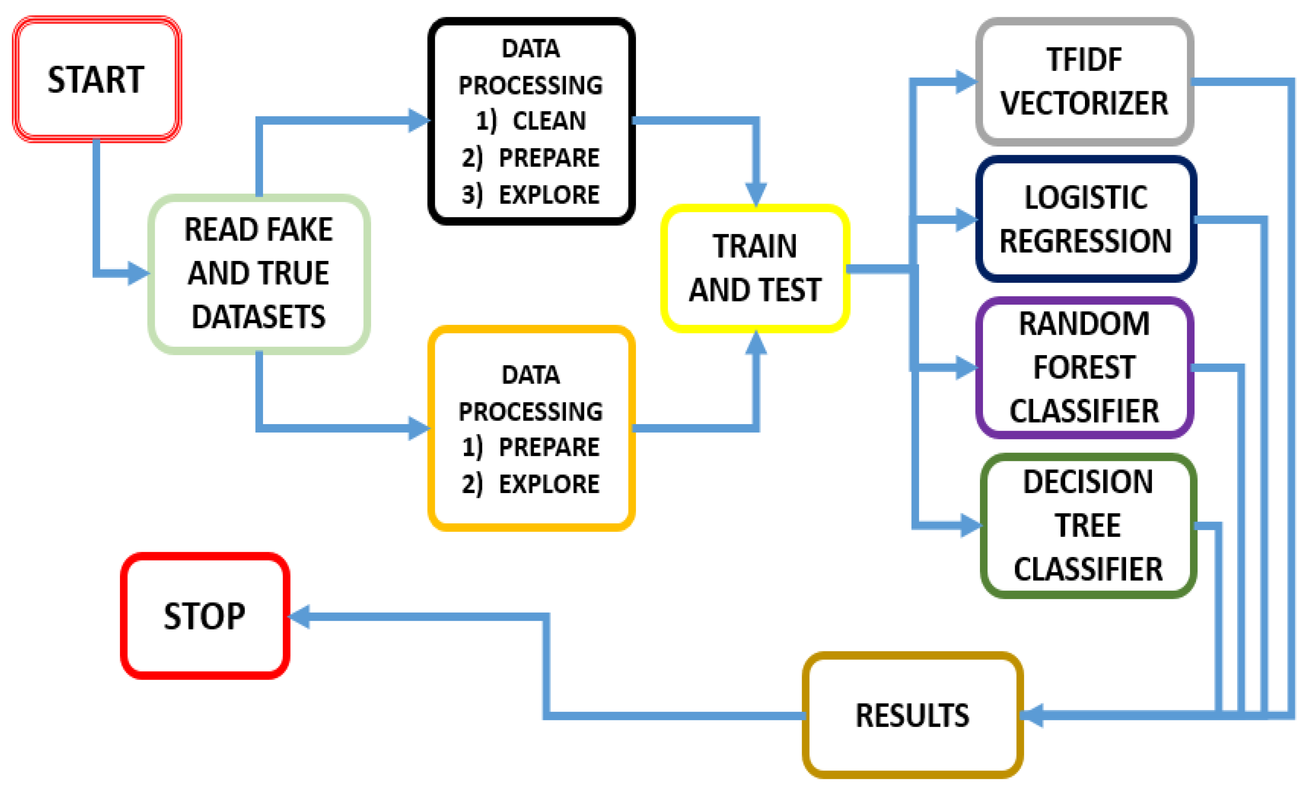
Framework

Slide 7
Dataset Description
The dataset was obtained from Kaggle. The true news data set contains 23481 posts, while the fake news data set contains 21417.
Among the features are the title and text, as well as the subject, date, and label. There are several categories of news topics, including political news, world news, government news, left news, and US news etc.

Slide 8
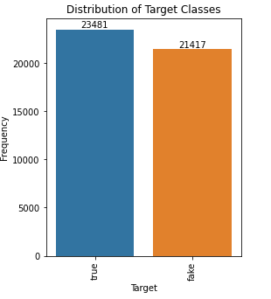
EDA : Chart 1
Equal Distribution between Fake News and Real News.
No chance of Bias.

Slide 9
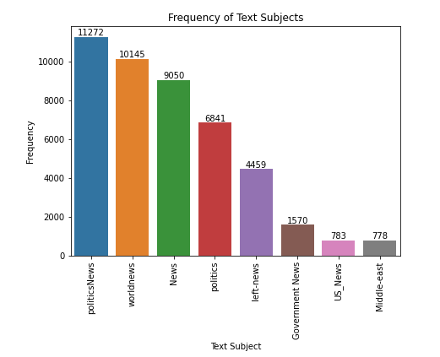
EDA : Chart 2
Top subjects of Fake News classified.
Lot of fake news is published with respect to Political News and World News.

Slide 10
Text Processing
Text Casing
Removal of Stopped Words
Removal of Punctuation
Removal of URL/Website taxonomy
Tokenizing
Checking Null and duplicate values

Slide 11
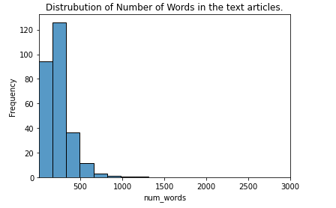
EDA : Chart 3
Most of the articles are having words less than 500

Slide 12
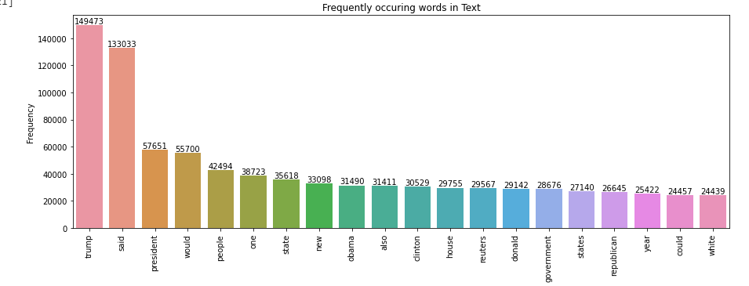
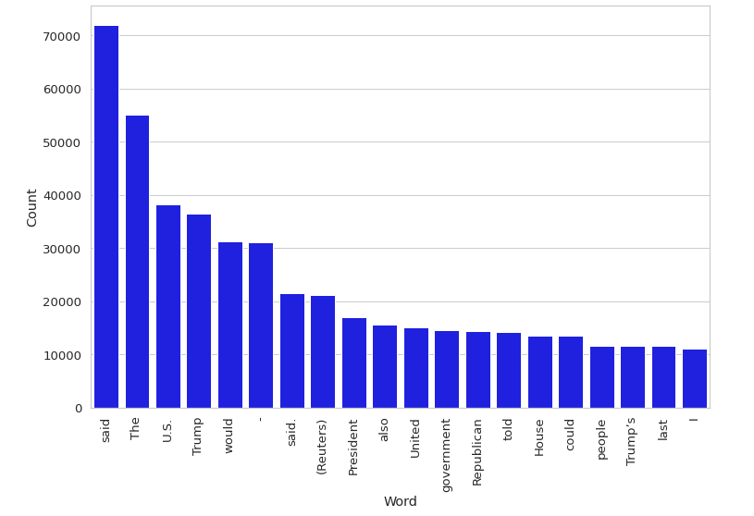
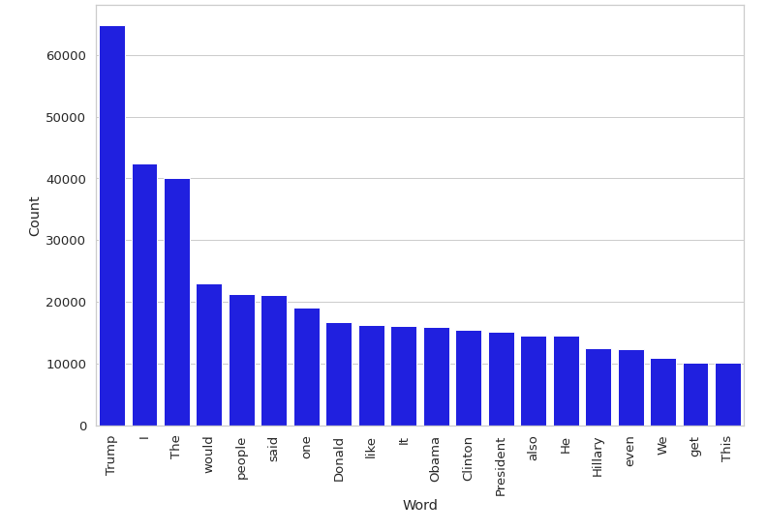
EDA : Chart 4
Unigram for the data
Notes:
1 : Fake

Slide 13
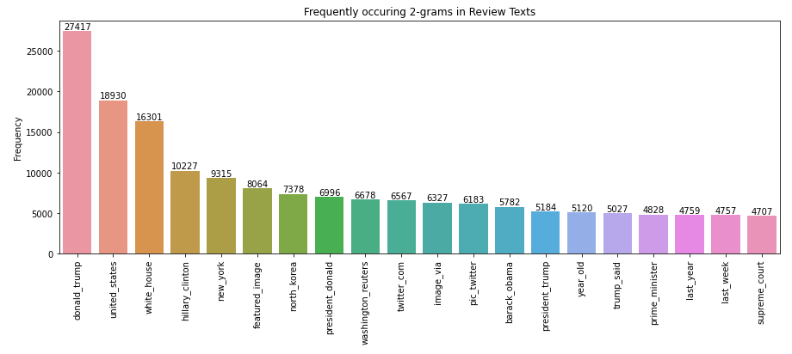
EDA : Chart 5

Slide 14
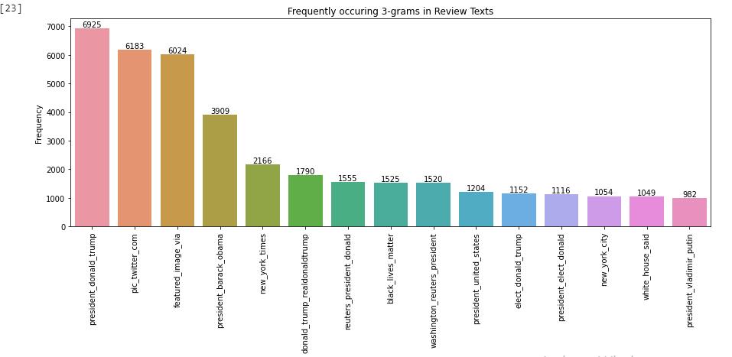
EDA : Chart 6

Slide 15
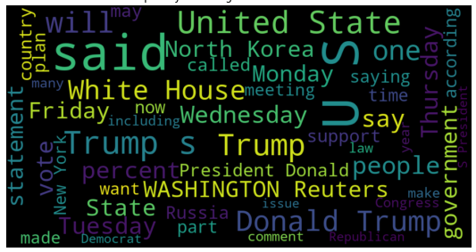
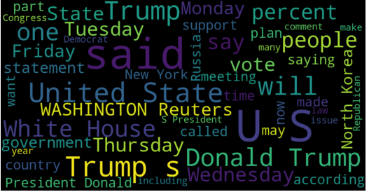
Chart 7 – Word Clouds
Frequently occurring words in fake Articles
Frequently occurring words in real Articles

Slide 16
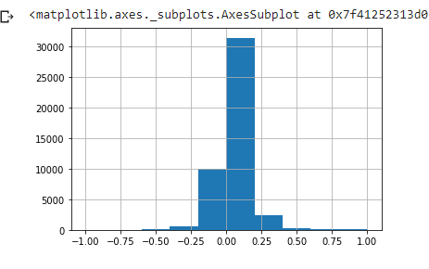
Sentiment Analysis
The process of detecting positive or negative sentiment in text is known as sentiment analysis.
We can use sentiment analysis to determine whether articles are reacting positively or negatively. If the distribution of true and fake articles differs significantly, these sentiments can be used as features.
polarity score is around zero

Slide 17
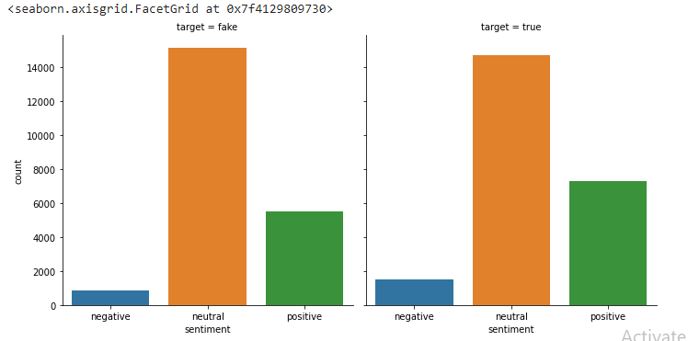
Chart 8
Sentiment counts for True and Fake News

Slide 18
Modeling
Modeling
Text Preprocessing
Vectorizing
Classification
Cleaning, Stemming, Contraction Removal, Special Char Removal, Tokenized
Count Vectorizer, TF-IDF
Model Training, predicting and validating the model performance.

Slide 19
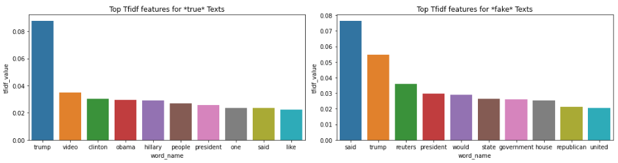
TF-IDF
TF-IDF is a popular algorithm for converting text into a meaningful representation of numbers, which is then used to fit machine learning algorithms for prediction. Words that occur frequently but should be given very little weightage or significance in TF-IDF vectors, which are related to one-hot encoded vectors.

Slide 20
Model Comparision
Naïve Bayes
Decision Tree
Random Forest
AdaBoost
Accuracy: 98.6%
Accuracy : 99.6%
Accuracy: 99.8%
Accuracy : 99.7%
Notes:
Table.

Slide 21
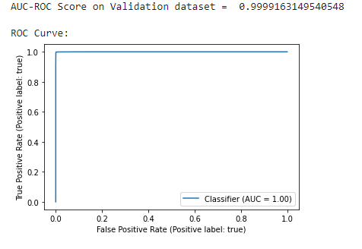
AUC – ROC curve
The ROC curve shows that both the true positive rate and the false positive rate are close to 1.0, and the area under the curve is 1.0, indicating that the model is performing well in classifying the news.

Slide 22
References
https://towardsdatascience.com/fake-news-detection-with-machine-learning-using-python-3347d9899ad1
https://www.csustan.edu/sites/default/files/groups/University%20Honors%20Program/Journals/02_stahl.pdf
https://arxiv.org/pdf/1805.08751.pdf
https://pressbooks.pub/fakenews/chapter/6-what-motivates-people-to-spread-fake-news-on-social-media/

